Slide 1

Introduction to XProc 3.0
Markup UK 2023 June 1-3, London
While waiting, maybe you can do some preparations?
Go to https://mu-2023-xproc.xatapult.com for instructions!

Slide 2

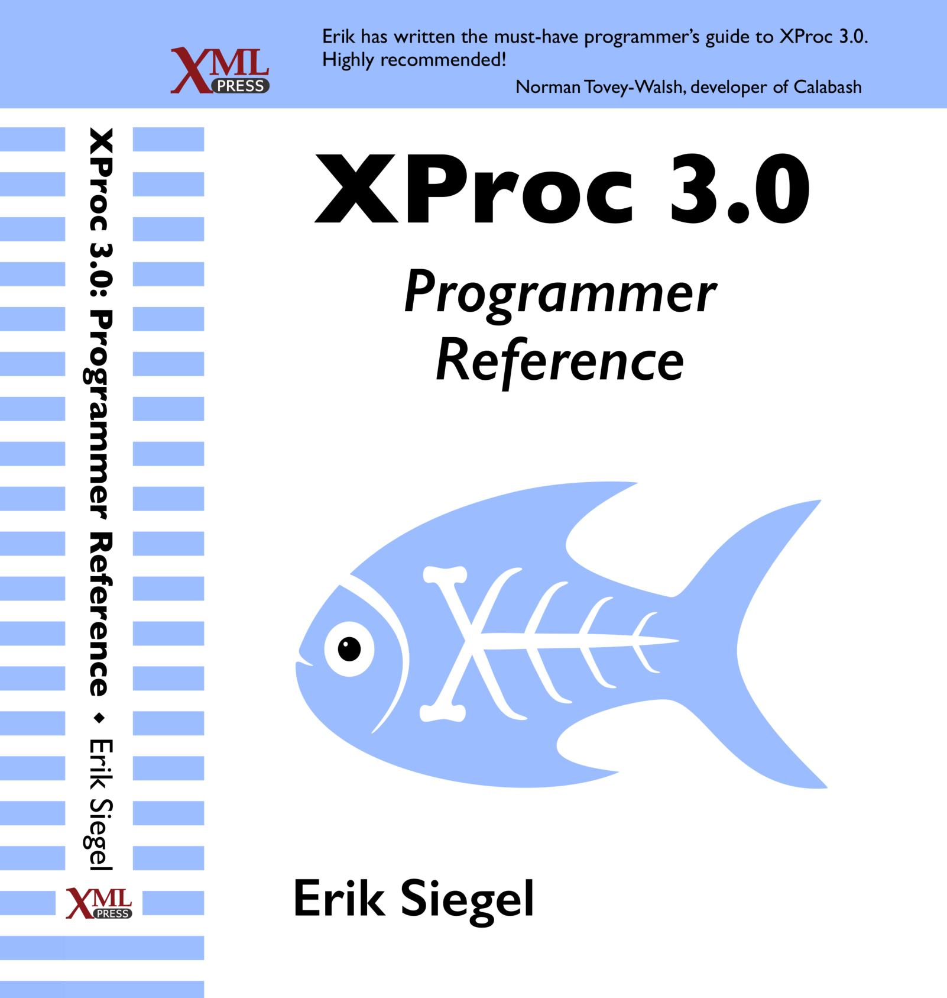
Who Am I?
Erik Siegel
Content Engineer and XML specialist
One-man company: Xatapult
Zwolle, The Netherlands
Member of the XProc 3.0 editing committee
Author of the XProc 3.0 Programmer Reference
Contact:
erik@xatapult.nl www.xatapult.com www.linkedin.com/in/esiegel/ +31 6 53260792

Slide 3
XProc?
XProc is an XML based programming language for complex data processing - pipelining
Extensible set of small, sharp tools for creating and transforming XML and other documents
V1.0 around since 2010 (two processor implementations to run your pipelines)
Specification of 3.0 final
One working processor (MorganaXProc-IIIse)
One under way (XML Calabash 3), almost there
My name is Kanava. I'm XProc's logo!

Slide 4
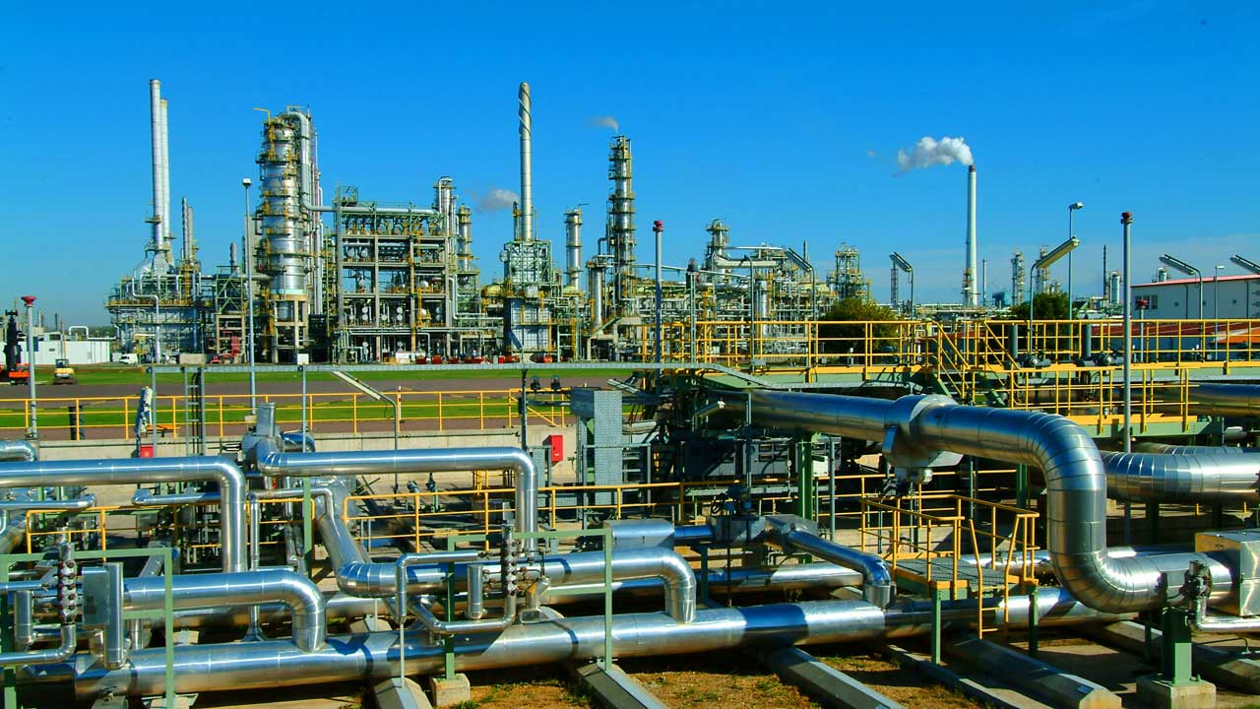
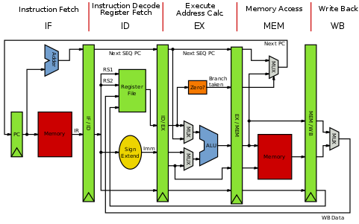

Why should I bother?
Pipelines are ubiquitous all around us
Solve problems with a set of small, sharp tools that combine in many ways
Like the UNIX command line
Compose small tools into something bigger, pipelines…
Very natural choice for document processing
XProc beats the alternatives
A successful example of large-scale application of XProc (1.0) pipelines:
https://www.le-tex.de/en/transpect.html

Slide 5

Hands-on: Installation and pre-flight check
Done all preparations?
Download/cloned the GitHub repository for this tutorial? https://github.com/xatapult/mu-2023-xproc
Java working on your machine?
Download and unpacked MorganaXProc-IIIse? https://sourceforge.net/projects/morganaxproc-iiise/
Added Morgana's main directory to the system's path?
Go to where you cloned/downloaded the tutorial's GitHub repository
Open a command window in exercises/01-hello-xproc/
Command: morgana pipeline.xpl
If it works you’ve just run your first XProc pipeline!
=================================
MorganaXProc-IIIse 1.1.4
Copyright 2011-2023 by <xml-project /> Achim Berndzen
=================================
<?xml version="1.0" encoding="UTF-8"?>
<hello-xproc timestamp="2023-05-10T11:14:27.21+02:00"/>

Slide 6

XProc fundamentals
You need to understand this!

Slide 7
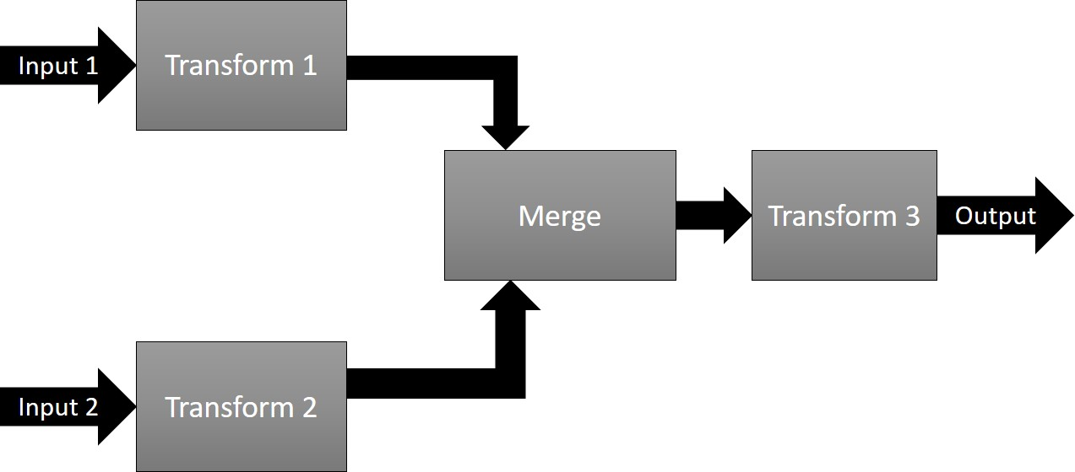
Pipelines, steps
Document(s) as input
Process the data flowing through using steps
Produce output(s)
Documents can be of any type, not just XML!

Slide 8
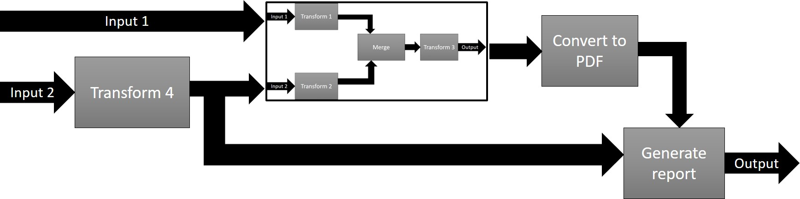
Pipelines, steps
In XProc, a pipeline and a step are essentially the same. The terms can be used interchangeably!

Slide 9
Supported document types
XML
HTML
JSON
Text
Binary/other
For instance: zip
<doc>
…
</doc>
Flow

Slide 10
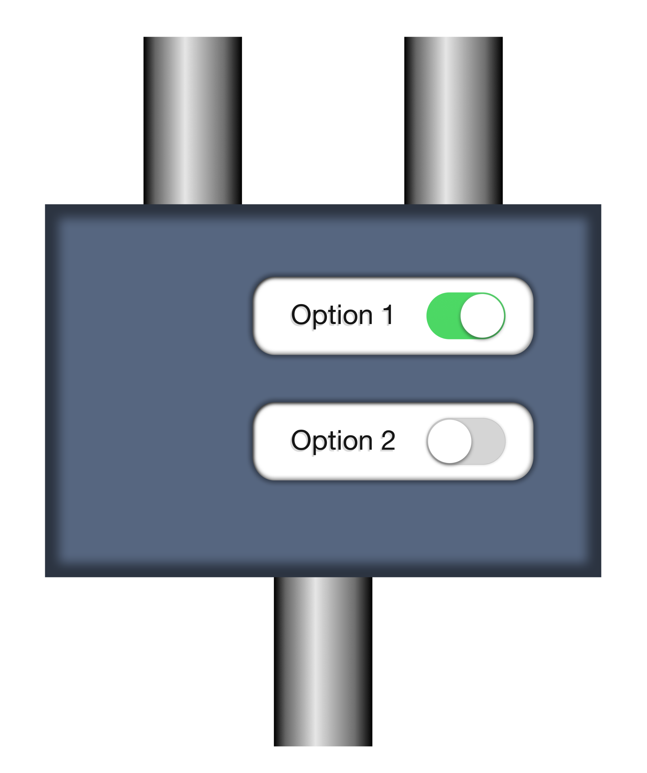
Steps/pipelines, ports, options
document
source
options:
p:add-attribute
match
attribute-name
attribute-value
result
Have a look ate the step specification: http://spec.xproc.org/master/head/steps/#c.add-attribute
Transformed document

Slide 11
The step libraries
Standard steps, see http://spec.xproc.org/master/head/steps/
These steps must be implemented in a conformant XProc processor!
Additional steps, see http://spec.xproc.org/master/head/#steps/
File handling, OS, validation, etc.
Implementation is optional (but recommended)
If such a step is implemented it must conform to what is written there
There are over 45 standard steps!

Slide 12
Step/pipeline that adds an attribute to the root
Root p:declare-step element
Namespace and preferred prefix (p:)
XProc version
<p:declare-step xmlns:p="http://www.w3.org/ns/xproc" version="3.0">
<p:input port="source"/>
<p:output port="result"/>
<p:add-attribute match="/*" attribute-name="timestamp"
attribute-value="{current-dateTime()}"/>
</p:declare-step>
Input port declaration
Output port declaration
You can specify option values as attributes on the step invocation
A step invocation
To compute stuff use Attribute-Value-Templates (AVTs), just like in XSLT.

Slide 13
Hands-on: Try it out
Open a command window in exercises/02-add-attribute/
Command: morgana pipeline.xpl -input:source=input.xml
Try it!
Whow, that’s a boring thing to do! I encourage you to experiment a bit …

Slide 14
Primary ports
source
Primary ports
p:something
result
The port names source and result for the primary ports are a convention
Not all ports are created equal…

Slide 15
Primary ports, implicit connections
source
<p:something …>
…
</p:something>
<p:something-else …>
…
</p:something-else>
p:something
Click!
Click!
result
source
Primary ports implicitly connect
p:something-else
Think of primary ports having little magnets that snap automagically together
result

Slide 16
Primary ports, implicit connections
If a step has only a single input or output port, they’re primary by default. But you can set the primary status explicitly using a primary=“true/false” attribute here.
<p:declare-step … >
<p:input port="source"/>
<p:output port="result"/>
<p:something …>
…
</p:something>
<p:something-else …>
…
</p:something-else>
</p:declare-step>
Implicit connection of
primary input port to first step
Implicit connection of last step to primary output port
Implicit connection of steps

Slide 17
Hands-on: Add a second attribute
Open a command window in exercises/02-add-attribute/
Change the pipeline and add a second p:add-attribute step that adds another attribute to the root element (or somewhere else).
Command: morgana pipeline.xpl -input:source=input.xml
Try it!
Easy….

Slide 18
Solution: Add a second attribute
<p:declare-step xmlns:p="http://www.w3.org/ns/xproc" version="3.0">
<p:input port="source"/>
<p:output port="result"/>
<p:add-attribute match="/*" attribute-name="timestamp"
attribute-value="{current-dateTime()}"/>
<p:add-attribute match="/*" attribute-name="enabled"
attribute-value="true"/>
</p:declare-step>

Slide 19

Ports and explicit connections
To an inline document
To an external document
To a port in the pipeline

Slide 20
The p:insert step
See: http://spec.xproc.org/master/head/steps/#c.insert
Base
document
Document to insert
source
insertion
options
p:insert
match
position
result
Possible values for position:
first-child
last-child
before
after
The source and result port are primary, the insertion port is not…
Combined document

Slide 21
Connect a port to an inline document
Explicitly connect something to a port using p:with-input
<p:somestep ...>
<p:with-input port="port-name">
... (inline XML document) ...
</p:with-input>
...
</p:somestep>
You can use expressions between curly braces {…} in your inline document
Expressions between curly braces are called TVTs (Text-Value-Templates and AVTs (Attribute-Value-Templates)

Slide 22
Hands-on: Add an additional child element using an inline document with p:insert
Open a command window in exercises/03-connect-inline/
Finish the pipeline so it adds a <location>London 2023</location> element after the <presenter> element
Use the p:insert step with an inline document
Options: match="/*" position="last-child"
Connect the inline document to the insertion port using <p:with-input port="…">
Compute the current year using a {…} construction
XPath cheat: year-from-date(current-date())
Command: morgana pipeline.xpl -input:source=input.xml
Try it!
Now you’re on your own writing XProc, scary…

Slide 23
Insert inline document - solution
<p:declare-step xmlns:p="http://www.w3.org/ns/xproc" version="3.0">
<p:input port="source"/>
<p:output port="result"/>
<p:insert match="/*" position="last-child">
<p:with-input port="insertion">
<location>London {year-from-date(current-date())}</location>
</p:with-input>
</p:insert>
</p:declare-step>

Slide 24
Connect a port to an external document
<p:somestep ...>
<p:with-input port="port-name" href="reference-to-document"/>
...
</p:somestep>
The href attribute is an AVT: You can use expressions between curly braces {…} inside
We have no means to add the current year now, like we did in the last exercise…

Slide 25
Hands-on: Add an additional child element using an external document with p:insert
Open a command window in exercises/04-connect-external/
Finish the pipeline so it adds the contents of insert.xml after the <presenter> element
Use the p:insert step with an href attribute
Options: match="/*" position="last-child"
Command: morgana pipeline.xpl -input:source=input.xml
Try it!

Slide 26
Insert external document - solution
<p:declare-step xmlns:p="http://www.w3.org/ns/xproc" version="3.0">
<p:input port="source"/>
<p:output port="result"/>
<p:insert match="/*" position="last-child">
<p:with-input port="insertion" href="insert.xml"/>
</p:insert>
</p:declare-step>

Slide 27
Add another port to our step and connect p:insert to it
source
extra
(our step)
result
The source and result port are primary, the extra port is not…

Slide 28
Add an additional input port to our step
We have more than two ports now: make explicit which ones are primary and which ones are not
<p:declare-step xmlns:p="http://www.w3.org/ns/xproc" version="3.0">
<p:input primary="true" port="source"/>
<p:output primary="true" port="result"/>
<p:input primary="false" port="extra"/>
...
</p:declare-step>
Add another input port to our step using <p:input>

Slide 29
Connect a port to another port in the same pipeline
Name the step/pipeline
<p:declare-step xmlns:p="http://www.w3.org/ns/xproc" version="3.0"
name="my-pipeline">
<p:input primary="true" port="source"/>
<p:output primary="true" port="result"/>
<p:input primary="false" port="extra"/>
<p:insert match="/*" position="last-child">
<p:with-input port="insertion" pipe="extra@my-pipeline"/>
</p:insert>
</p:declare-step>
Use the pipe attribute with "portname@stepname"

Slide 30
Hands-on: Add an external document with p:insert
Open a command window in exercises/05-connect-internal/
Command: morgana pipeline.xpl -input:source=input.xml –input:extra=insert.xml
Try it!
Change this pipeline so it now inserts its primary input document in itself, directly after the inserted <location> element…
<tutorial>
<name>Introduction to XProc 3.0</name>
<presenter>Erik Siegel</presenter>
<location>London</location>
<tutorial>
<name>Introduction to XProc 3.0</name>
<presenter>Erik Siegel</presenter>
</tutorial>
</tutorial>
Not very useful but nonetheless insightful

Slide 31
Insert external document - solution
<p:declare-step xmlns:p="http://www.w3.org/ns/xproc" version="3.0"
name="my-pipeline">
<p:input primary="true" port="source"/>
<p:output primary="true" port="result"/>
<p:input primary="false" port="extra"/>
<p:insert match="/*" position="last-child">
<p:with-input port="insertion" pipe="extra@my-pipeline"/>
</p:insert>
<p:insert match="/*" position="last-child">
<p:with-input port="insertion" pipe="source@my-pipeline"/>
</p:insert>
</p:declare-step>
Re-read the document from the step's source port

Slide 32
Hands-on: Change a document and insert it into the primary document
Our pipeline
extra
source
Change document
(add-attribute)
result
insertion
source
source
Insert changed document
result
result

Slide 33
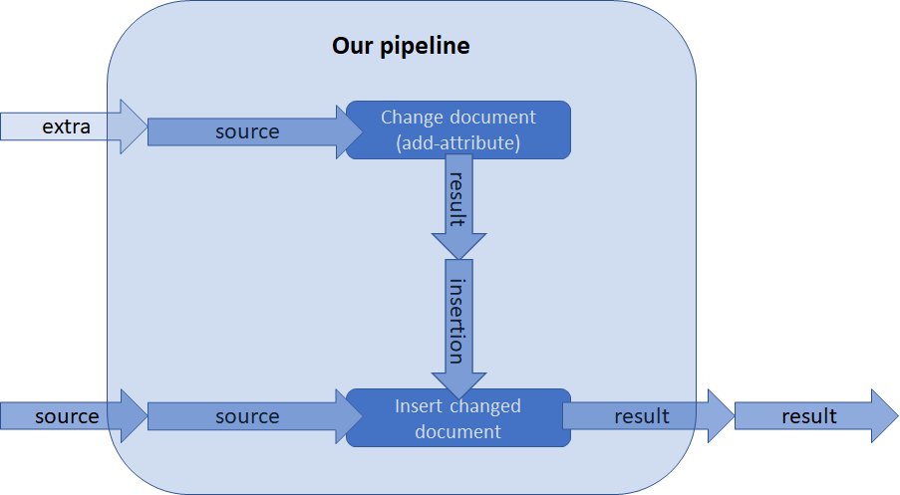
Hands-on: Change a document and insert it into the primary document
Open a command window in exercises/05b-connect-internal/
Change this pipeline so the extra document is changed first before the insert
Command: morgana pipeline.xpl -input:source=input.xml –input:extra=insert.xml
Try it!

Slide 34
Change a document and insert it into the primary document - solution
<p:declare-step xmlns:p="http://www.w3.org/ns/xproc" version="3.0" name="my-pipeline">
<p:input primary="true" port="source"/>
<p:output primary="true" port="result"/>
<p:input primary="false" port="extra"/>
<p:add-attribute match="/*" attribute-name="extra" attribute-value="true"
name="change-extra-document">
<p:with-input port="source" pipe="extra@my-pipeline"/>
</p:add-attribute>
<p:insert match="/*" position="last-child">
<p:with-input port="source" pipe="source@my-pipeline"/>
<p:with-input port="insertion" pipe="result@change-extra-document"/>
</p:insert>
</p:declare-step>
Explicit connection because p:insert is no longer the first step!

Slide 35
Ports and implicit connections
To an inline document
Add the XML inside the <p:with-input>
To an external document
Use the href attribute on <p:with-input>
To a port in the pipeline
Name the steps you want to read from and use the pipe attribute on <p:with-input>

Slide 36

Options and variables
Add an option to your pipeline
Variables
Other ways to set options

Slide 37
Your own options
We’ve seen that built-in steps can have options
What if you want to add an option to your own step?
Declare the option in the prolog of your step
Optionally add a default value
(XPath expression!)
<p:declare-step xmlns:p="http://www.w3.org/ns/xproc" version="3.0">
<p:input port="source"/>
<p:output port="result"/>
<p:option name="username" select="'erik'"/>
<p:add-attribute match="/*" attribute-name=“username"
attribute-value="{upper-case($username)}"/>
</p:declare-step>
You can make an option required, set a datatype, supply a default, etc.
Reference the option using the $... notation, just like XSLT and XQuery

Slide 38
Hands-on: Add options
Open a command window in exercises/06-add-option/
Command: morgana pipeline.xpl -input:source=input.xml –option:username=(your-name)
Try it!
Change this pipeline so the name of the username attribute can be changed also, using an option called aname

Slide 39
Add an option - solution
<p:declare-step xmlns:p="http://www.w3.org/ns/xproc" version="3.0">
<p:input port="source"/>
<p:output port="result"/>
<p:option name="username" select="'erik'"/>
<p:option name="aname" select="'username'"/>
<p:add-attribute match="/*" attribute-name="{$aname}"
attribute-value="{upper-case($username)}"/>
</p:declare-step>

Slide 40
Variables
<p:declare-step xmlns:p="http://www.w3.org/ns/xproc" version="3.0">
<p:input port="source"/>
<p:output port="result"/>
<p:option name="username"/>
<p:variable name="id" select="upper-case($username) || '-' ||
p:system-property('p:episode')" />
<p:add-attribute match="/*" attribute-name="id" attribute-value="{$id}"/>
</p:declare-step>
Declare the variable anywhere
Reference the variable using the $... notation, just like XSLT and XQuery
Variables can be of any datatype, just like in XSLT or XQuery

Slide 41
Variables values from the documents flowing through
<some-root status="final">
…
</some-root>
Read values from the document flowing through!
<p:variable name="status" select="/*/@status" />

Slide 42
Hands-on: Use a variable
Open a command window in exercises/07-use-variable/
Add a variable that catches the value of the <presenter> element
<p:variable name="…" select="…"/>
Add this value as an attribute to the root
Command: morgana pipeline.xpl -input:source=input.xml
Try it!

Slide 43
Use a variable - solution
<p:declare-step xmlns:p="http://www.w3.org/ns/xproc" version="3.0">
<p:input port="source"/>
<p:output port="result"/>
<p:variable name="presenter" select="//presenter[1]"/>
<p:add-attribute match="/*" attribute-name="presenter"
attribute-value="{$presenter}"/>
</p:declare-step>
Get some value from the document flowing through
Reference the variable using the $... notation

Slide 44
Alternative…
<p:declare-step xmlns:p="http://www.w3.org/ns/xproc" version="3.0">
<p:input port="source"/>
<p:output port="result"/>
<p:add-attribute match="/*" attribute-name="presenter"
attribute-value="{//presenter[1]}"/>
</p:declare-step>

Slide 45

How to set an option?
As attribute on a step's invocation: <p:add-attribute match="…" …/>
Works for data types that can be cast from a string (strings, booleans, integers doubles, etc.)
If the option's data type is a map you can use a map constructor: parameters="map{ 'par1':'value-for-par1' }"
Using the <p:with-option> child element… but be careful!

Slide 46
Using <p:with-option>
<p:add-attribute match="/*" attribute-name="x" attribute-value="{1 + 2}"/>
The match expression should be interpreted by the step (and not by the pipeline), so it must be passed as a string!
<p:add-attribute>
<p:with-option name="match" select="'/*'"/>
<p:with-option name="attribute-name" select="'x'"/>
<p:with-option name="attribute-value" select="1 + 2"/>
</p:add-attribute>
The select attribute(s) contain XPath expressions

Slide 47
Hands-on: Use p:with-option
Open a command window in exercises/08-use-with-option/
Replace the attributes on the <p:add-attribute> by <p:with-option> elements
Command: morgana pipeline.xpl -input:source=input.xml
Try it!
Try what happens when you forget to make the match option a string…

Slide 48
Use p:with-option - solution
<p:declare-step xmlns:p="http://www.w3.org/ns/xproc" version="3.0">
<p:input port="source"/>
<p:output port="result"/>
<p:add-attribute>
<p:with-option name="match" select="'/*'"/>
<p:with-option name="attribute-name" select="'timestamp'"/>
<p:with-option name="attribute-value"
select="string(current-dateTime())"/>
</p:add-attribute>
</p:declare-step>

Slide 49
When to use what for setting options?
Style…
Attributes are easier (?)
<p:with-option> is more explicit (?)
When the datatype of an option cannot be cast from a string, you must use <p:with-option>
For instance, when the option requires a sequence as value: <p:with-option name="…" select="(…, …, …)"/>

Slide 50
Options and variables
Add an option to your pipeline
<p:option> in the prolog
Reference option as a variable
Variables
Declare them anywhere using <p:variable>
Other ways to set options
Either attribute or <p:with-option>

Slide 51

Compound steps
What are compound steps?
What steps do we have?
Example of using the p:for-each step

Slide 52
The core (or compound) steps
p:for-each: loop over multiple documents, or parts of a document
p:choose / p:when / p:otherwise: Make choices
p:if: Make a single choice (no else)
p:viewport: Work on only a part of a document
p:try / p:catch: Error catching and handling
p:group: Grouping of instructions
Regrettably, there is no time to look at them all…

Slide 53
Use p:if to make a decision
<p:if test="…">
</p:if>
The code here only executes when the test expression is true
When the expression is false, the input simply "falls through", without change

Slide 54
Hands-on: Use p:if to make a decision
Open a command window in exercises/09-use-if/
The input document input.xml has a status attribute
Write the code for pipeline.xpl so that: If /*/@status has the value error, add an additional attribute to the root: special-handling="true"
Try it!
Command: morgana pipeline.xpl -input:source=input.xml

Slide 55
Use p:if to make decision – Solution
<p:declare-step xmlns:p="http://www.w3.org/ns/xproc" version="3.0">
<p:input port="source"/>
<p:output port="result"/>
<p:if test="/*/@status eq 'error'">
<p:add-attribute match="/*" attribute-name="special-handling" attribute-value="true"/>
</p:if>
</p:declare-step>

Slide 56
Multiple decisions? Use p:choose
<p:choose>
<p:when test="…">
…
</p:when>
<p:when test="…">
…
</p:when>
<p:otherwise>
…
<p:otherwise>
</p:when>

Slide 57
Use p:for-each to split a document - Input
<documents>
<doc filename="output1.xml">
<contents>This is document number 1</contents>
</doc>
<doc filename="output2.xml">
<contents>This is document number 2</contents>
<more>It has some more...</more>
</doc>
</documents>
Split this in multiple documents
The filenames are in filename attributes
Boring contents Erik

Slide 58
Use p:for-each to split a document – Basic pipeline
<p:declare-step xmlns:p="http://www.w3.org/ns/xproc" version="3.0">
<p:input port="source"/>
<p:output port="result"/>
<p:for-each>
<p:with-input select="//doc"/>
<p:store href="{/*/@filename}"/>
</p:for-each>
</p:declare-step>
p:for-each has an anonymous input port…
select is a standard attribute of p:with-input
The p:store step stores a document to disk. The href attribute tells it where
p:store emits on its result port the same document as it received on its source port

Slide 59
Hands-on: Use p:for-each to split a document - 1
Open a command window in exercises/10-for-each/
Command: morgana pipeline.xpl -input:source=input.xml
Try it!
It does not run… why? What does the error message tell you?
Make the result port of the pipeline accept a sequence by adding a sequence="true" attribute
What is the result of this pipeline?
So how many documents flow out of this step now?

Slide 60
Use p:for-each to split a document – Solution
Make the output port accept a sequence
<p:declare-step xmlns:p="http://www.w3.org/ns/xproc" version="3.0">
<p:input port="source"/>
<p:output port="result" sequence=“true"/>
<p:for-each>
<p:with-input select="//doc"/>
<p:store href="{/*/@filename}"/>
</p:for-each>
</p:declare-step>
You can also define what document types a port will accept
What flows out of the p:for-each are a sequence of documents!

Slide 61
The p:wrap-sequence step
See: http://spec.xproc.org/master/head/steps/#c.wrap-sequence
Multiple documents
source
options
p:wrap-sequence
wrapper
group-adjacent
With the group-adjacent option you can group incoming documents based on an XPath expression. We’re not going to try that now
result
wrapped document(s)

Slide 62
Hands-on: Use p:for-each to split a document - 2
(Re)Open a command window in exercises/10-for-each/
Add a p:wrap-sequence step to wrap the sequence of result documents in a <result> element
Command: morgana pipeline.xpl -input:source=input.xml
Try it!

Slide 63
Use p:for-each to split a document 2 – Solution
<p:declare-step xmlns:p="http://www.w3.org/ns/xproc" version="3.0">
<p:input port="source"/>
<p:output port="result"/>
<p:for-each>
<p:with-input select="//doc"/>
<p:store href="{/*/@filename}"/>
</p:for-each>
<p:wrap-sequence wrapper="result"/>
</p:declare-step>
Wrap the results in a <result> element

Slide 64
Use p:viewport to change parts of a document - Input
<documents>
<doc keep="true">
<p>Hi there!</p>
</doc>
<doc keep="false">
<p>Nonsense!</p>
</doc>
<doc keep="true">
<p>Hi there again!</p>
</doc>
</documents>
Replace every doc with @keep="false" with <DELETED/>

Slide 65
p:viewport
<p:viewport match="…">
</p:viewport>
Replace the matched nodes with what you produce in here

Slide 66
The p:identity step
See: https://spec.xproc.org/master/head/steps/#c.identity
source
Just copy what's on the source port to the result port…
p:identity
result

Slide 67
Hands-on: Use p:viewport to change parts of a document
Open a command window in exercises/11-viewport/
Finish the code so every <doc> with @keep="false" is replaced by a <DELETED/> element
Try it!
Command: morgana pipeline.xpl -input:source=input.xml

Slide 68
Use p:viewport to change parts of a document – Solution
<p:declare-step xmlns:p="http://www.w3.org/ns/xproc" version="3.0">
<p:input port="source"/>
<p:output port="result"/>
<p:viewport match="doc[not(xs:boolean(@keep))]">
<p:identity>
<p:with-input port="source">
<DELETED/>
</p:with-input>
</p:identity>
</p:viewport>
</p:declare-step>
Use p:identity to create an element

Slide 69

Wrap up
Fundamentals
Steps
Ports
Primary ports, implicit port connections
Explicit port connections
To an inline document, external document or some port elsewhere in the pipeline
Options and variables
Declare options and variables
Use attributes or <p:with-option>
Compound steps
But there is much more to explore!

Slide 70
Goodbye and thank the fish!
Main site: https://xproc.org/
Two processor implementations
https://www.xml-project.com/ (MorganaXProc)
https://xmlcalabash.com/ (XML Calabash, 3.0 work in progress)
Programmer Reference: https://xmlpress.net/publications/xproc-3-0/
Your guide today: Erik Siegel – erik@xatapult.nl
Kanava stickers: FREE!
Goodbye!
And remember, Kanava says:
XProc rocks…

